Slide 1

Accuracy, Precision, Recall and F1 Score. AUC(Area under the ROC Curve) and ROC Curve.
Talabi Damilare Hannah.
17/08/2024.

Slide 2
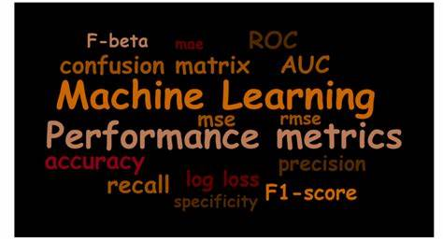

Table of content
Introduction.
Definition of terms.
Uses.
Conclusion.

Slide 3

Introduction
In the realm of Machine Learning, particularly for classification tasks, evaluating a model’s performance is essential to ensure its effectiveness in real-world applications. Various metrics provide different perspectives on a model’s performance, each highlighting specific aspects of the classification process.
Among the most commonly used metrics are Accuracy, Precision, Recall, F1 Score, AUC (Area Under the ROC Curve), and the ROC Curve itself. Understanding these metrics is crucial not only for assessing a model’s overall performance but also for making informed decisions about model selection, tuning, and deployment.
This introduction aims to provide an overview of these metrics, explaining their significance, the scenarios in which they are most useful, and how they guide the evaluation and improvement of machine learning models.

Slide 4

Definition of terms

Slide 5
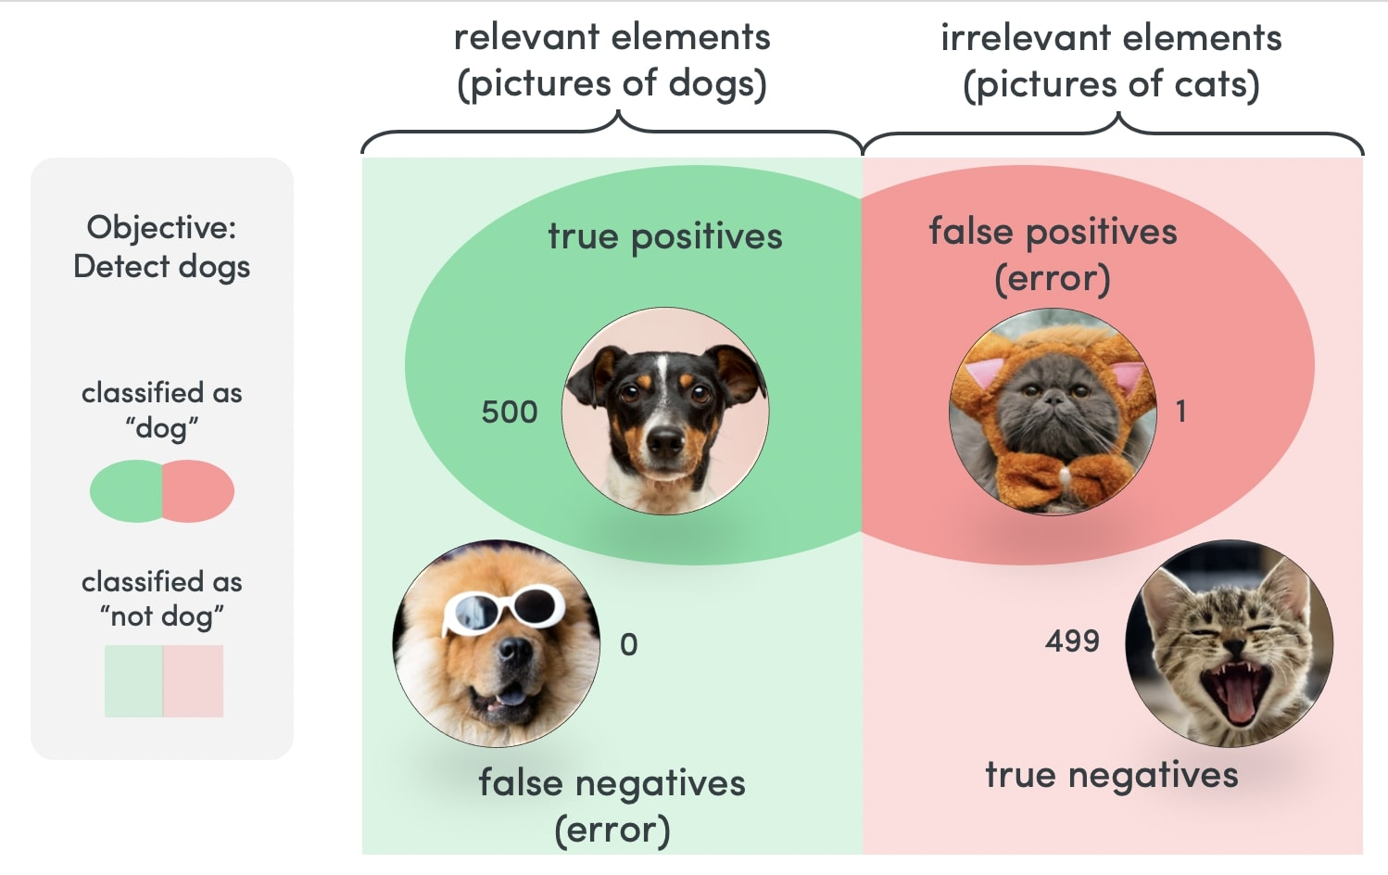
Confusion Matrix Terms
True Positive (TP): The model correctly identifies a dog as a dog. This is a good outcome.
True Negative (TN): The model correctly identifies an animal(cat) that is not a dog. This is also a good outcome.
False Positive (FP): The model incorrectly identifies a dog as a dog. This is a false alarm.
False Negative (FN): The model incorrectly identifies a dog as not dog. This is a missed spam.

Slide 6
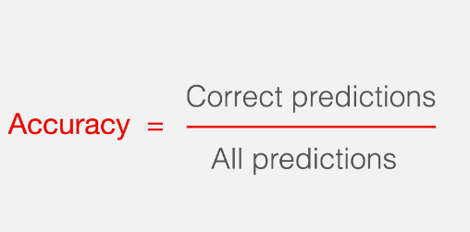

Accuracy
Accuracy is the proportion of correct predictions (both true positives and true negatives) out of the total number of predictions made by a model. It's calculated as:
Accuracy = (TP + TN) / (TP + TN + FP + FN)
In ML: Accuracy is the most straightforward metric, representing the proportion of correctly classified instances out of the total instances. While it's a useful general indicator, its value can be misleading, especially in imbalanced datasets where one class is much more frequent than the other. For example, if you have a dataset with 95% negatives and 5% positives, a model that predicts everything as negative will still have 95% accuracy, but it’s clearly not useful.

Slide 7
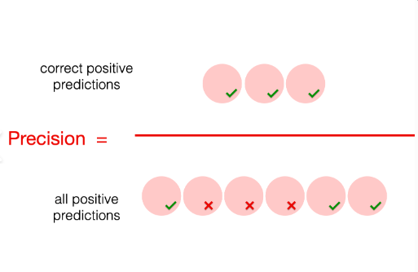
Precision
Precision measures the proportion of positive predictions that were actually correct (true positives) out of all positive predictions made. It's calculated as:
Precision = TP / (TP + FP)
In ML: Precision focuses on the quality of positive predictions. It measures how many of the instances predicted as positive are actually positive. High precision indicates that the model has a low false positive rate, which is crucial in scenarios where false positives are costly, such as in email spam detection or fraud detection.

Slide 8
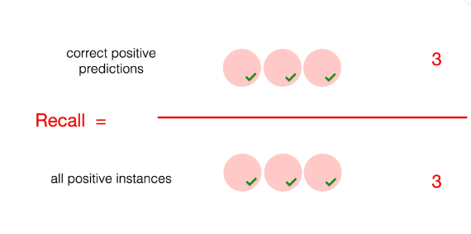
Recall
Recall measures the proportion of actual positive cases that were correctly identified (true positives) out of all actual positive cases. It's calculated as:
Recall = TP / (TP + FN)
In ML: Recall, or Sensitivity, measures the model's ability to identify all positive instances. It focuses on minimizing false negatives, which is vital in situations where missing a positive instance is more critical than accidentally flagging a few negatives as positives. For instance, in medical diagnostics, missing a disease (false negative) could be far more dangerous than incorrectly diagnosing it (false positive).

Slide 9
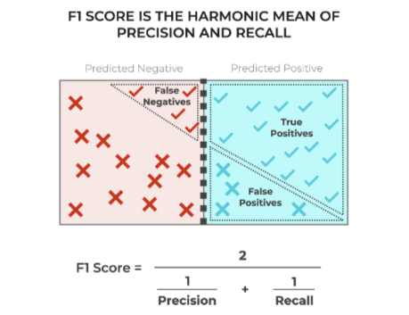
F1 Score
The F1 score is the harmonic mean of precision and recall. It provides a balance between precision and recall. It's calculated as:
F1 Score = 2 * (Precision * Recall) / (Precision + Recall)
In ML: The F1 Score combines Precision and Recall into a single metric by taking their harmonic mean. It provides a balanced view, especially when you need to consider both false positives and false negatives. The F1 Score is particularly useful when you have an uneven class distribution and need a metric that gives equal importance to Precision and Recall.

Slide 10
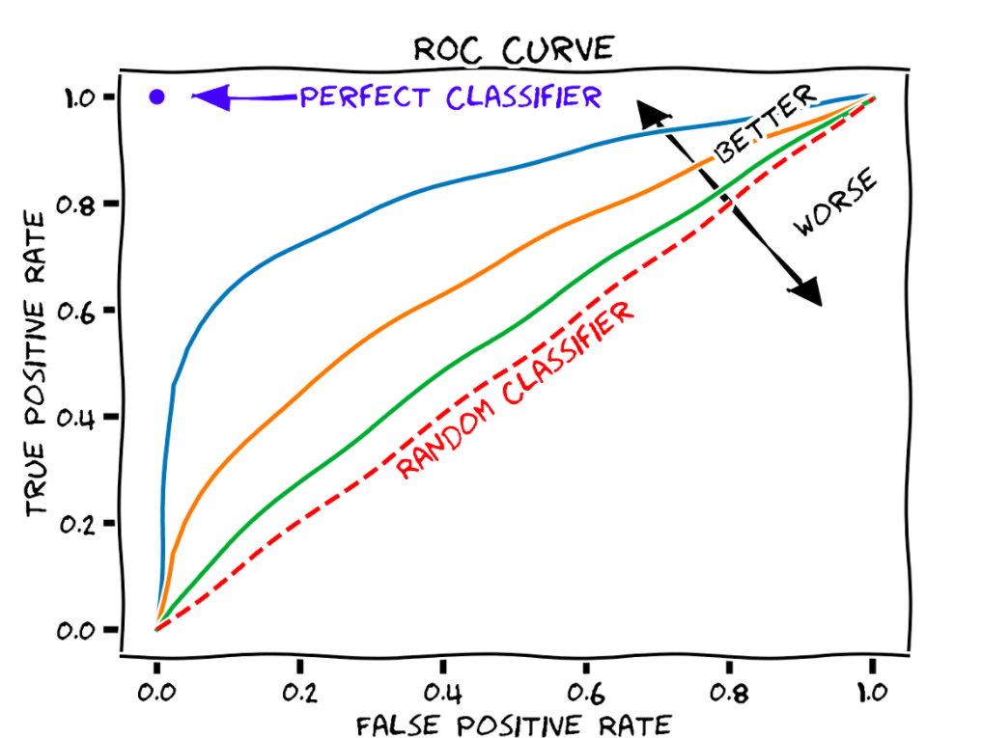
ROC Curve
Receiver Operating Characteristic Curve
The ROC curve is a graphical plot that illustrates the diagnostic ability of a binary classifier system as its discrimination threshold is varied. It plots the true positive rate (sensitivity) against the false positive rate (1 - specificity) for different classification thresholds.
In ML: The ROC Curve is a graphical representation that shows the trade-off between the True Positive Rate (Recall) and the False Positive Rate (1-Specificity) at various threshold settings. The curve helps visualize the model's performance across different thresholds and can be used to select an optimal threshold for classification based on the specific needs of the application.

Slide 11
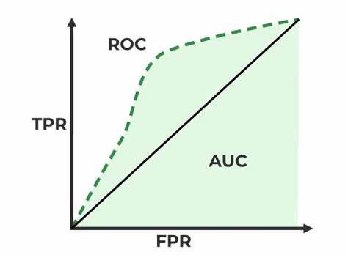
AUC
Area Under the ROC Curve
AUC measures the performance of a classification model across all classification thresholds. It represents the probability that a randomly chosen positive instance will be ranked higher than a randomly chosen negative instance. An AUC of 1 indicates perfect classification, while an AUC of 0.5 indicates random guessing.
In ML: The AUC score provides an aggregate measure of performance across all classification thresholds. It evaluates how well the model can distinguish between positive and negative classes. An AUC of 1.0 represents a perfect model, while an AUC of 0.5 suggests a model no better than random guessing. AUC is particularly useful when dealing with imbalanced classes, as it evaluates the model's ability to distinguish between the two classes without being affected by the threshold.

Slide 12
Uses of each Metric.
Accuracy
Use:
Use:
Recall
Use:
F1 Score
ROC and AUC
Use:
Use:
Accuracy is a straightforward metric to understand, but it can be misleading in imbalanced datasets. It is best used when the cost of false positives and false negatives are roughly equal.
Precision
Precision is useful when minimizing false positives is crucial. For example, in a spam filter, you want to have high precision to avoid flagging legitimate emails as spam.
Recall is important when its critical to capture as many positive cases as possible, even if it means accepting some false positives. For instance. In medical diagnosis, you want to have high recall to identify as many diseased patients as possible.
F1 Score is valuable when you need to consider both precision and recall simultaneously. Its often used in text classification and information retrieval.
AUC is widely used in binary classification problems.
ROC Curve helps you visualize the trade-off between sensitivity and specificity. It is useful for comparing models and choosing the optimal threshold for your specific application

Slide 13



Summary
These metrics are essential tools for evaluating the performance of machine learning models, particularly in classification tasks. Understanding their definitions and use cases allows you to choose the appropriate metric(s) for your specific problem and model.

Slide 14
Thank you!
Talabi Damilare Hannah
damilaretalabi9@gmail.com

